Slide 1
Customer Churn Prediction
Tools used for Analzing Data : Python(jupyter Notebook), Machine Leaning, Excel

Slide 2
Objectives:
Customer attrition or churn, is when customers stop doing business with a company. It can have a significant impact on a company's revenue and it's crucial for businesses to find out the reasons why customers are leaving and take steps to reduce the number of customers leaving. One way to do this is by identifying customer segments that are at risk of leaving, and implementing retention strategies to keep them. Also, by using data and machine learning techniques, companies can predict which customers are likely to leave in the future and take actions to keep them before they decide to leave.
We are going to build a basic model for predicting customer churn using Customer Churn dataset. We are using some classification algorithm to model customers who have left, using Python tools such as pandas for data manipulation and matplotlib for visualizations.

Slide 3
Steps Involved to Predict Customer Churn
Importing Libraries
Loading Dataset
Exploratory Data Analysis
Outliers using IQR method
Cleaning and Transforming Data
One-hot Encoding
Rearranging Columns
Feature Scaling
Feature Selection
Prediction using Logistic Regression
Prediction using Support Vector Classifier
Prediction using Decision Tree Classifier

Slide 4
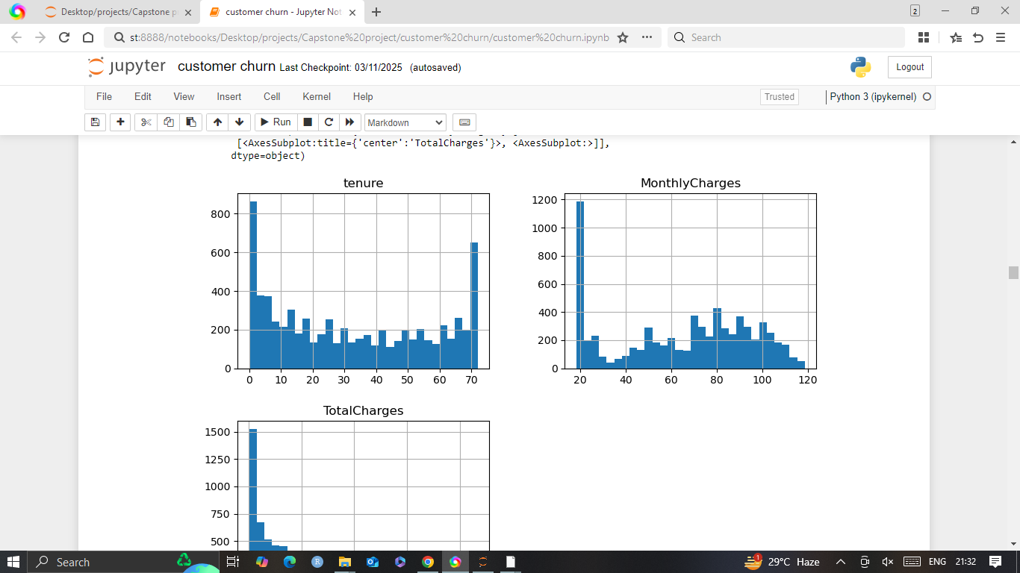
observations of Tenure,MonthlyCharges,TotalCharges

Slide 5
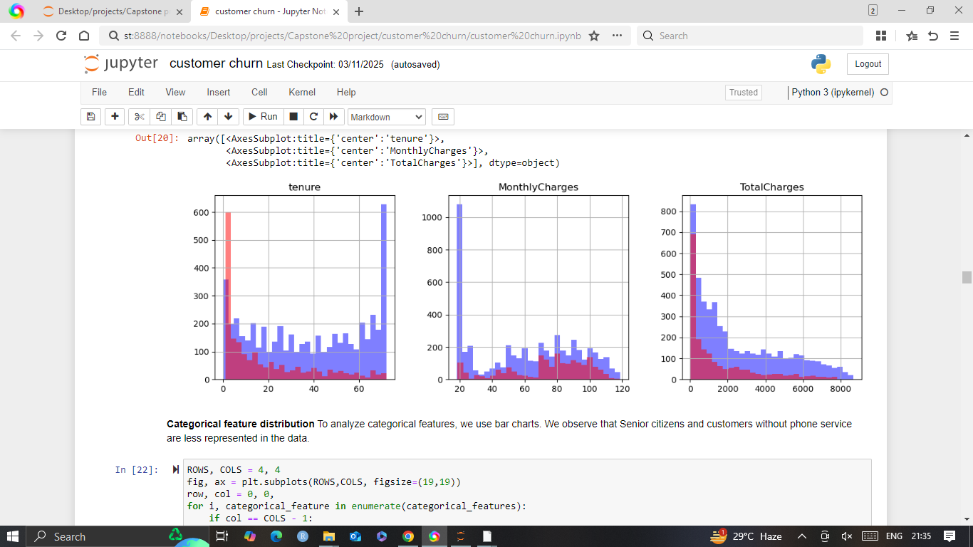
Categorical feature distribution

Slide 6
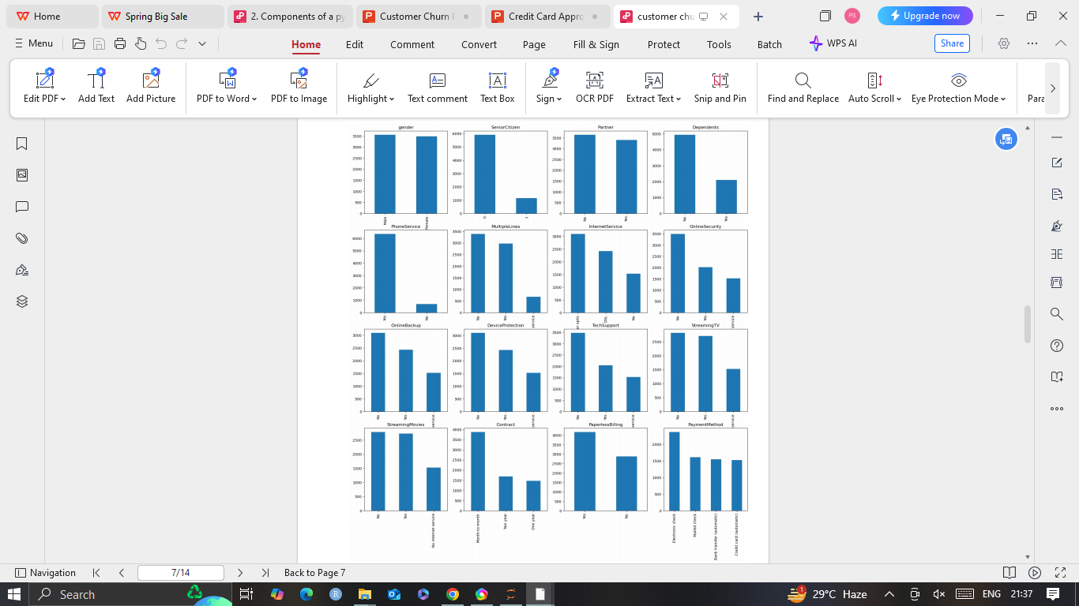

Slide 7
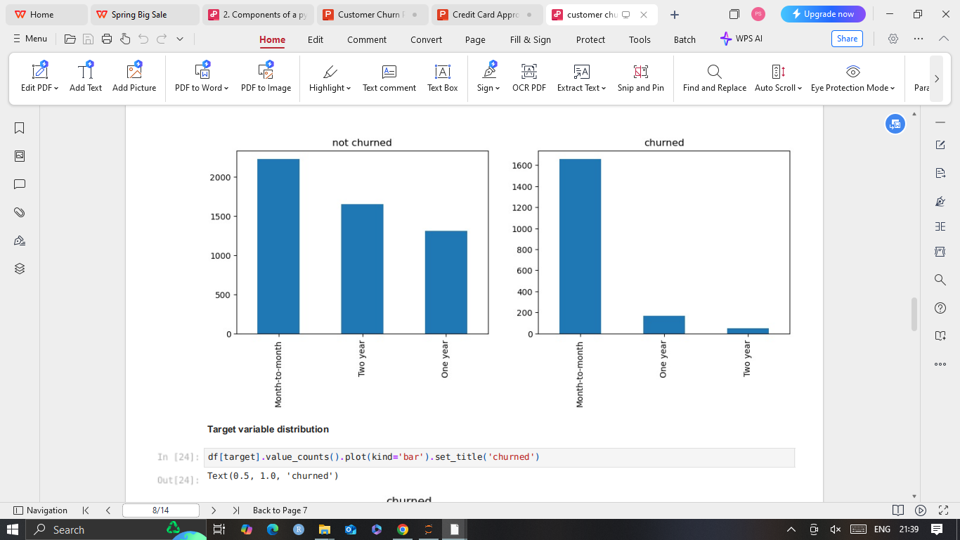
Target Variable Distribution

Slide 8
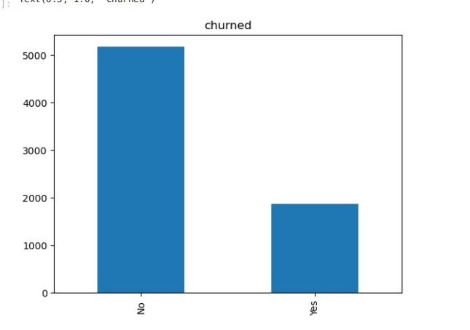
Target variable distribution shows that we are dealing with an imbalanced problem as there are many more non-churned as compare to churned users. The model would achieve high accuracy as it would mostly predict majority class - users who didn't churn in our example.

Slide 9
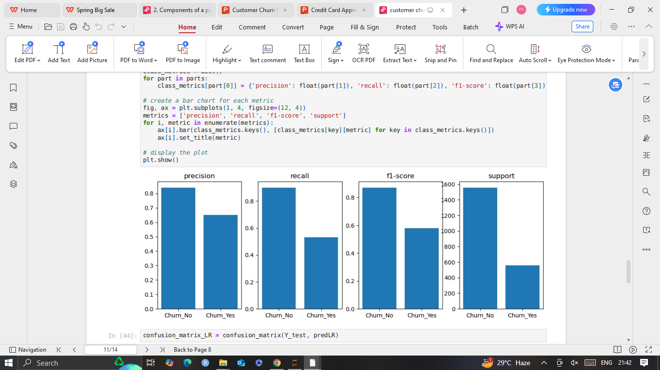
Classification Report:

Slide 10
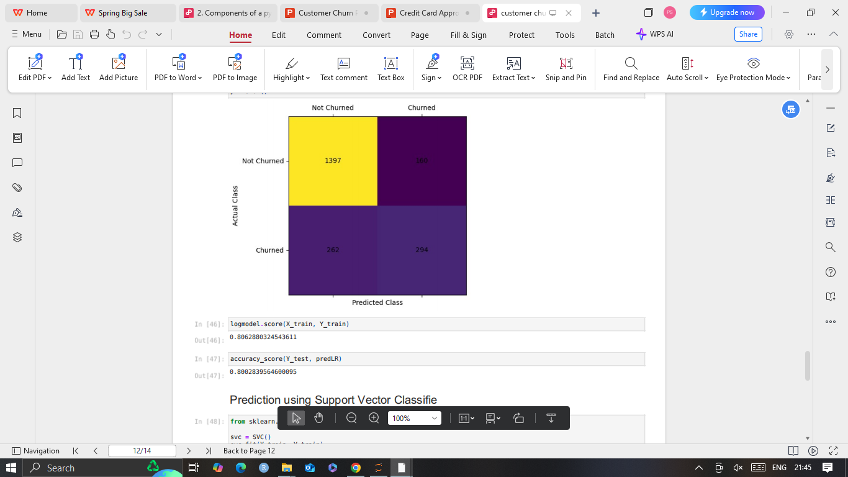
Confusion Matrix:

Slide 11
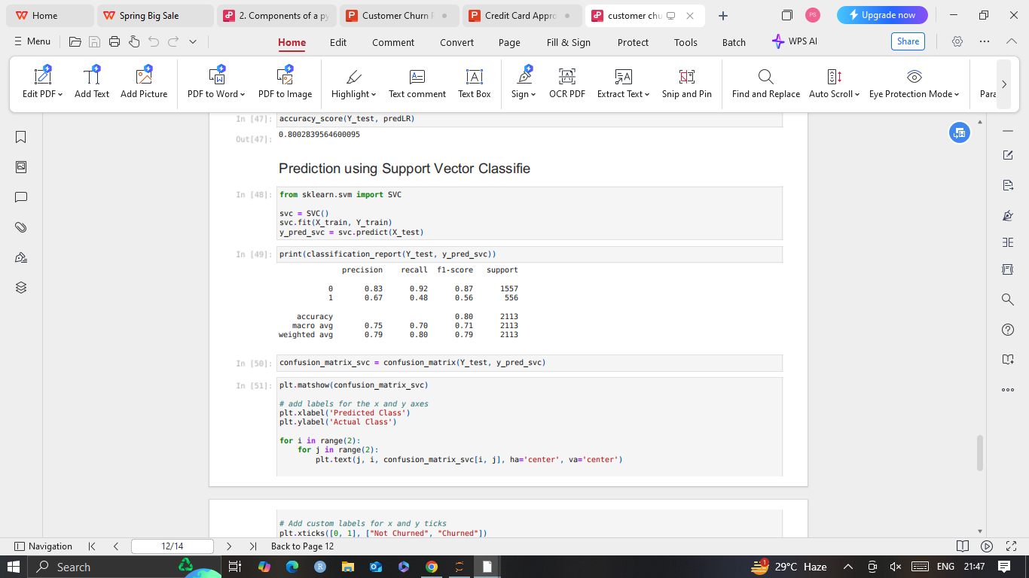
Support Vector Classifie:

Slide 12
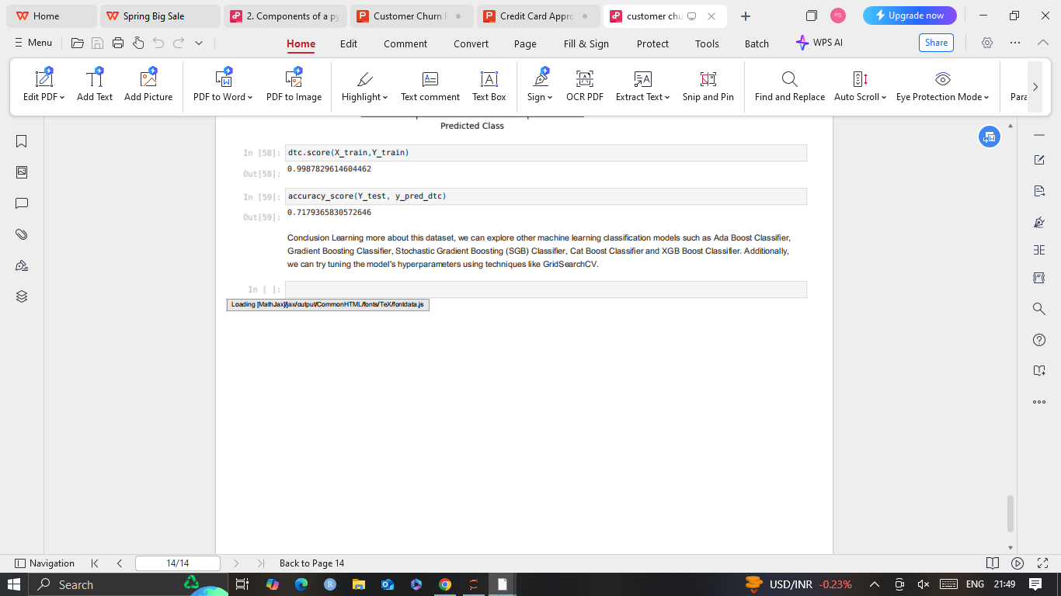
Dtc Score & Accuracy Score:

